Slide 1
8085 Instruction set & addressing mode

Slide 2
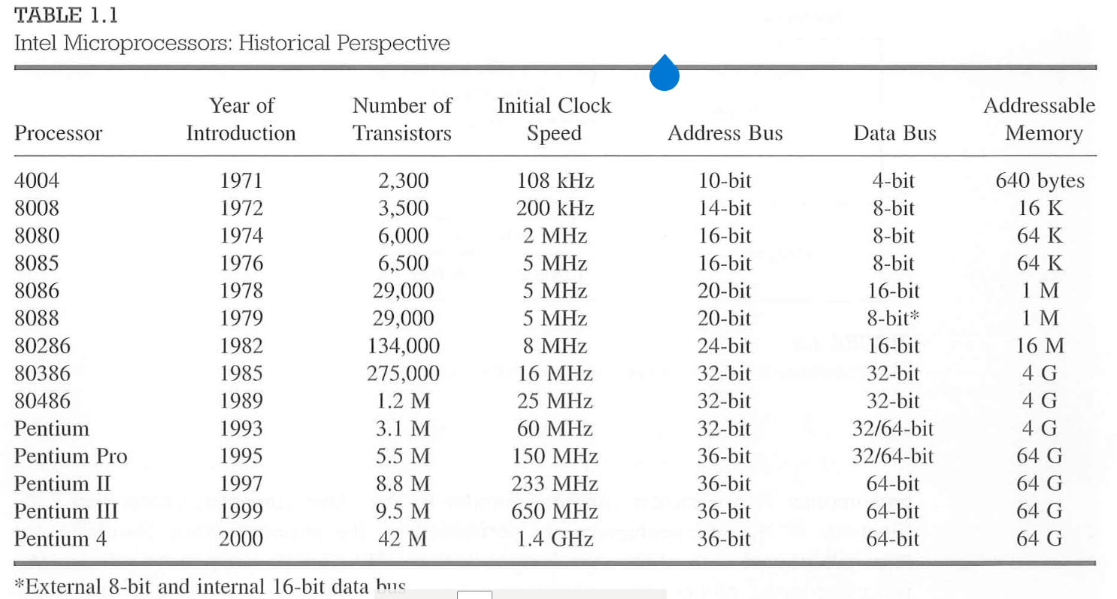
MICROPROCESSORS HISTORY

Slide 3
POINTS TO REMEMBER . . .
Microprocessor uses buses for connecting different components & peripherals.
There are three types of buses being used. They are 1. Data bus 2. Address bus and 3. Control bus.
8085 has 8 bit data lines and so why it is referred to be as a microprocessor.
8085 has 16 address lines.
ALU (Arithmetical and Logical unit) is one of the most important components of a microprocessor which performs all arithmetical and logical operations.
There are 6 general purpose registers:- B,C,D,E,H & L
Accumulator, Program counter, Stack pointer are all referred to be as special function registers. They are all meant for a specific purpose.

Slide 4
CONTD.,
Stack pointer is a register which points to the temporary storage area within the available memory.
Program counter is a 16 bit register that will hold the address of the next instruction to be executed.
8085 has flag register which helps in getting the status of the arithmetic operations.
The operating frequency of 8085 is 3 MHz.
Interrupt and Polling are the options available for handling multiple processes.
Interrupt is the best option comparing polling.
TRAP carries a very high priority and it cannot be stopped by any command or any other mask. It is of the highest priority among all the other interrupts.

Slide 5
Processor Cycles
Instruction Cycle:
The sequence of operations that a processor has to carry out while executing the instruction is called instruction cycle.
Machine Cycle:
Each instruction cycle of a processor consist of a number of basic operations called machine cycles or processor cycles.
Instruction Cycle
Fetch Cycle
Execute Cycle

Slide 6
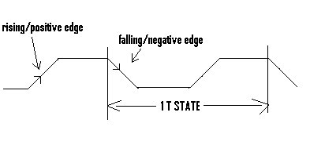
T States
The time taken by the processor to execute a machine cycle is expressed in T - States.
One T – state is equal to the time period of the internal clock signal of the processor.
The T- state starts at the falling edge of a clock.

Slide 7
8085 – HOW AN INSTRUCTION
WILL LOOK LIKE?
What is an instruction?
It is a command that can make the microprocessor perform a specific function.
All instructions are collectively grouped as instruction set.
An Instruction is basically a combination of two parts one is operation code and the next is operands.

Slide 8
Operation code is also called as opcode.
The opcode will be used to identify what kind of operation needs to be performed.
Operands can be one or two based on the instruction.
Operands will be used to spot the source and destination. An operand can be any of the following:
Registers (like Accumulator, B register and so on)
Immediate value (Say 10H, 010101B)
An address, i.e. memory location. (Say 30H)
Any of the supported input or output ports.

Slide 9
ADDRESSING MODES
8085 supports five types of addressing:
The addressing modes are
Immediate Addressing
Direct Addressing
Register Addressing
Register Indirect Addressing
Implicit Addressing

Slide 10
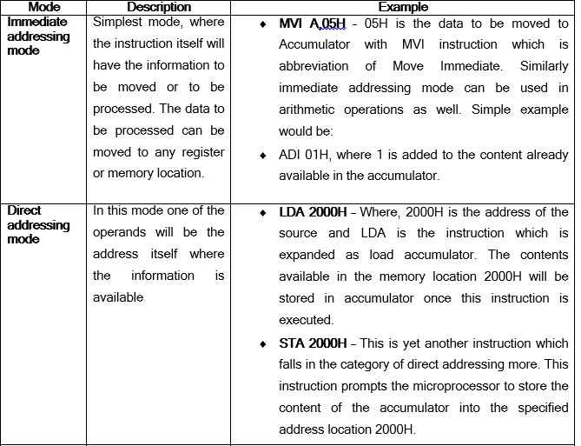

Slide 11
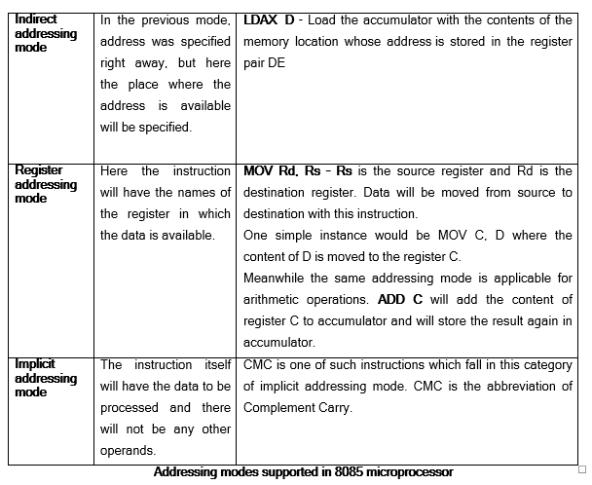

Slide 12
8085 – INSTRUCTION SET.
246 instructions are available in 8085.
The instruction set can be classified as follows:
Data transfer instructions
Arithmetic instructions
Logical instructions
Branching instructions and
Control instructions.

Slide 13
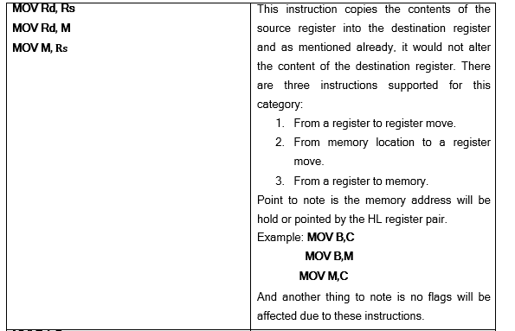
1. Data transfer instructions – it is used for moving data from source to destination. The content of source will not be modified after the data transfer is complete. It will remain the same.

Slide 14
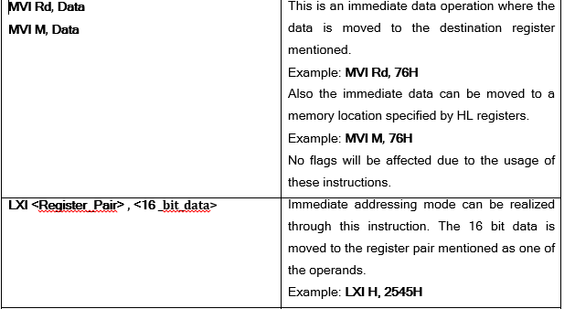

Slide 15
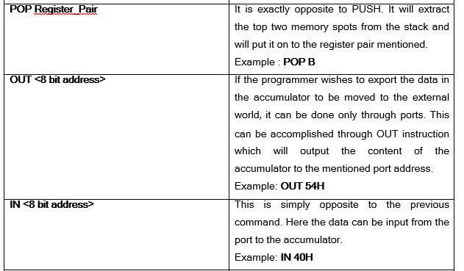

Slide 16
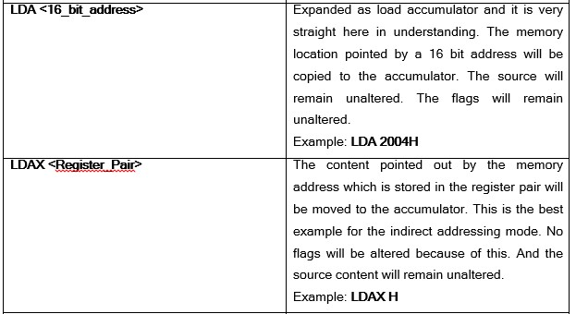

Slide 17
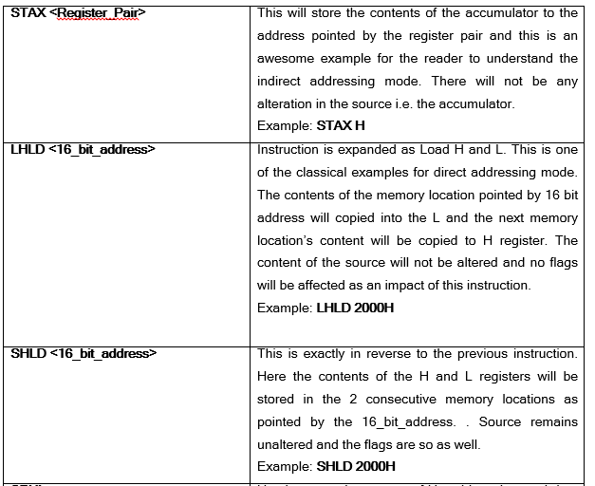

Slide 18
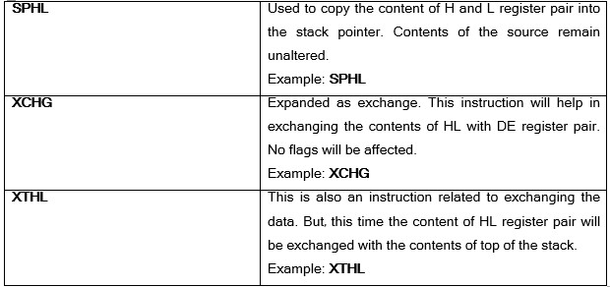

Slide 19
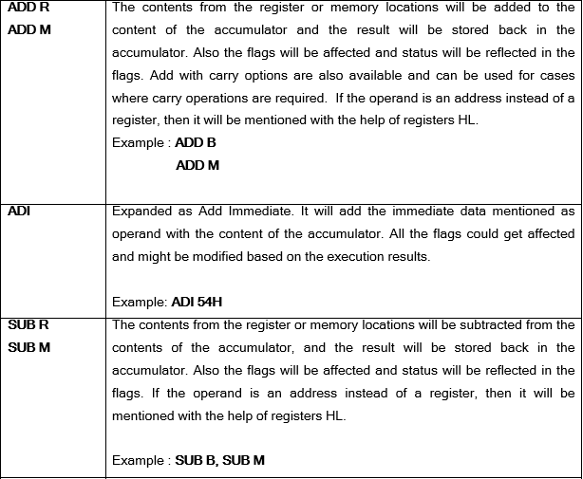
2. ARITHMETIC INSTRUCTIONS

Slide 20
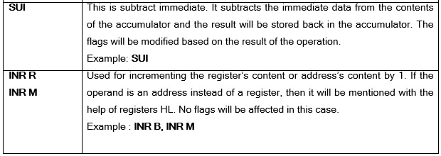

Slide 21
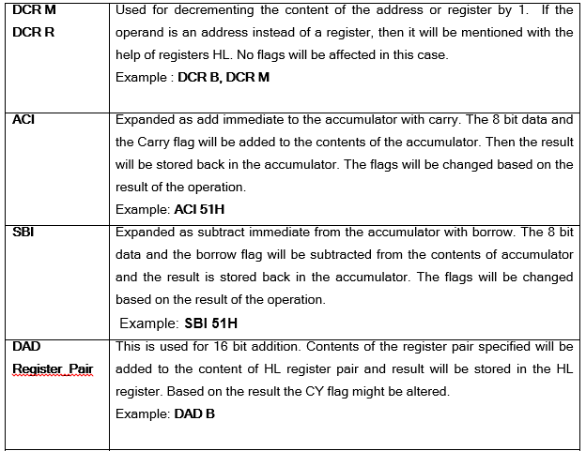

Slide 22
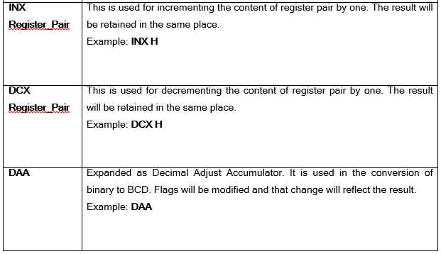

Slide 23
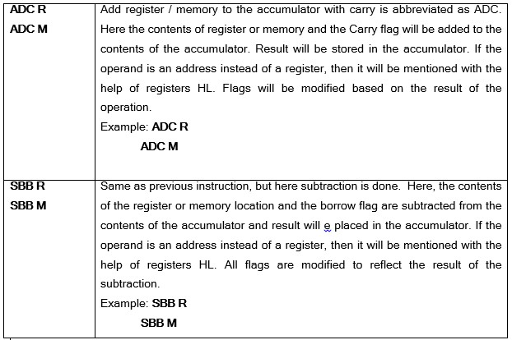

Slide 24
3. LOGICAL INSTRUCTIONS
Points to be noted before learning/reading on logical instructions are summarized as follows:
One of the operands must be stored in the accumulator without which it would not be possible to use the logical instructions.
Any addressing mode can be used with the logical instructions. There is no restriction in this regard.
All the instructions that perform logical operations are categorized under LOGICAL instruction set.

Slide 25
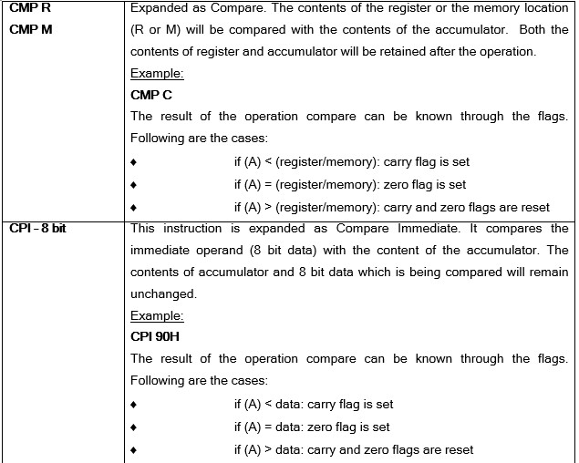

Slide 26
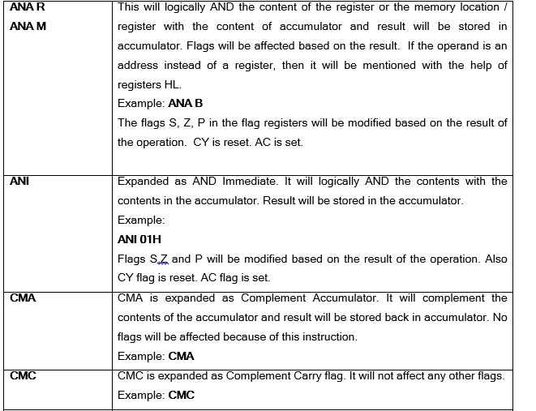

Slide 27
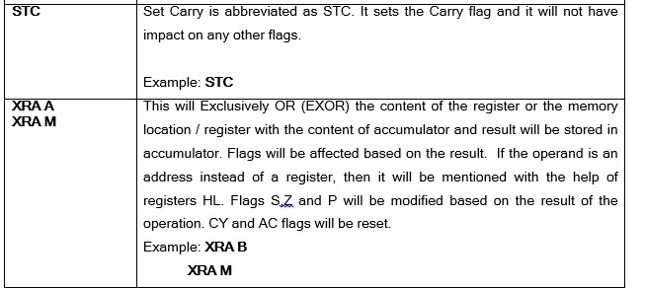

Slide 28
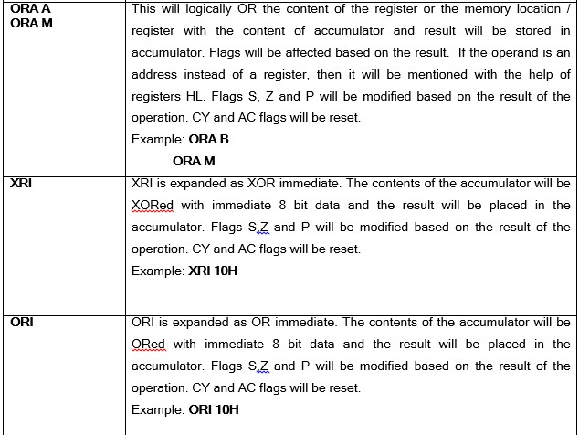

Slide 29
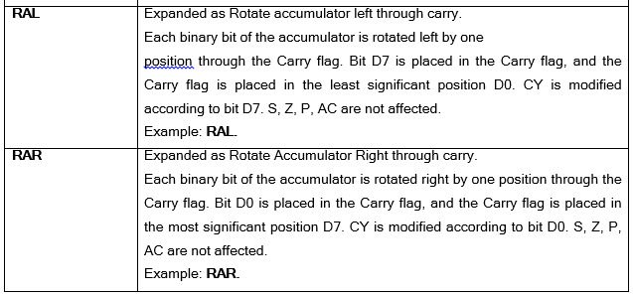

Slide 30
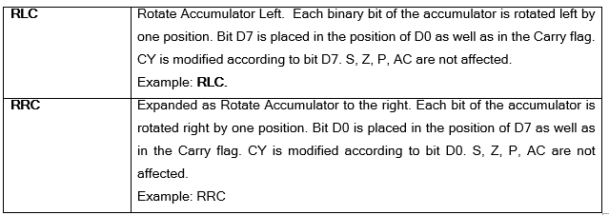

Slide 31
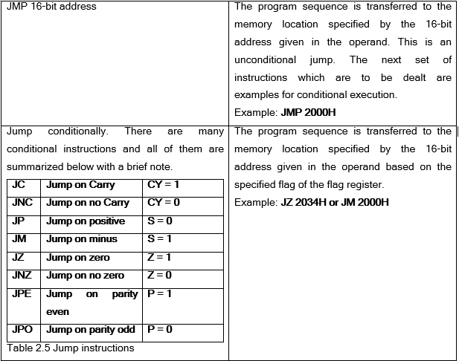
4. BRANCHING INSTRUCTIONS
Used to alter the normal flow and shift the control to the different address/area.

Slide 32
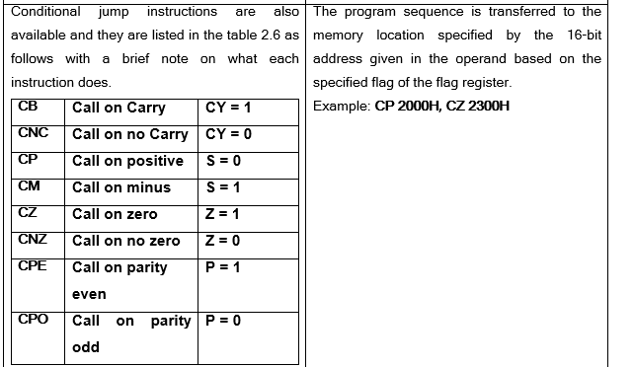

Slide 33
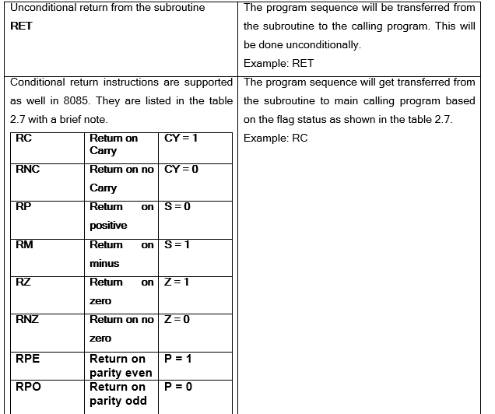

Slide 34
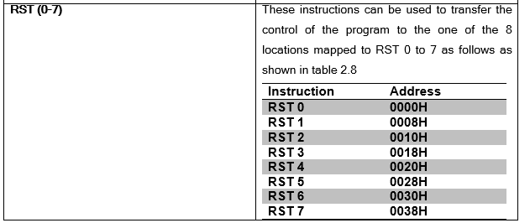

Slide 35
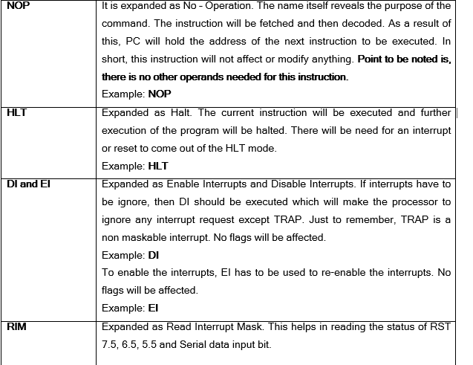
5. Control instructions
Microprocessor is controlled by these control instructions

Slide 36
Thank You
Reference: Chapter 2, Ramesh Gaonkar, 8085 Microprocessor Architecture Programming and applications with the 8085

